Slide 1


Slide 2


Network Types
Understanding Internet, Intranet and Extranet
Wired vs Wireless
Open-Source Interconnect (OSI) Layers
IP Addresses, MAC Addresses, and Port Numbers
Understanding Public and Private Addresses
IPv4 Addressing and Subnetting
IPv6 Addressing and Types
Understanding Stand-Alone vs Domain Network Types
Understanding LAN and WAN connections
Understanding Virtual Private Network Connections
File and Printer Sharing
Computer Network Fundamentals

Slide 3
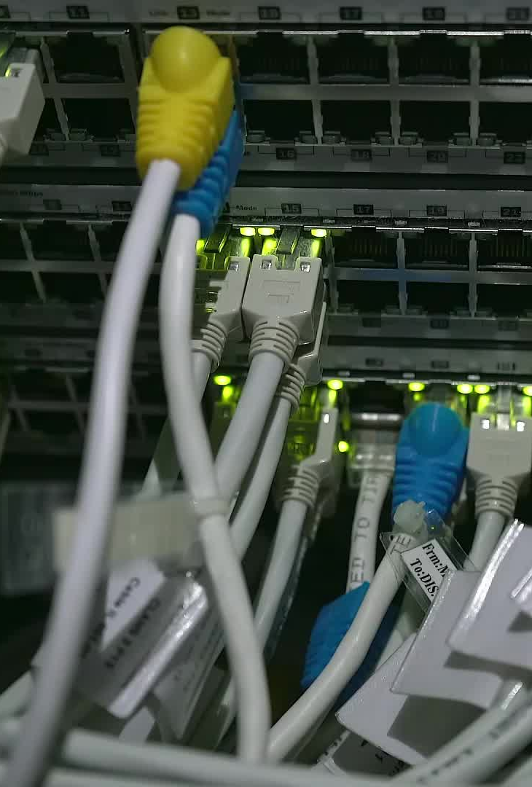
POPULAR NETWORK TYPES
Personal Area Network (PAN)
Local Area Network (LAN)
Wireless Local Area Network (WLAN)
Campus Area Network (CAN)
Metropolitan Area Network (MAN)
Wide Area Network (WAN)
Storage-Area Network (SAN)
Enterprise Private Network (EPN)
Virtual Private Network (VPN)

Slide 4
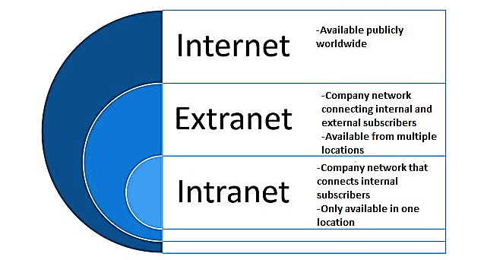

Slide 5
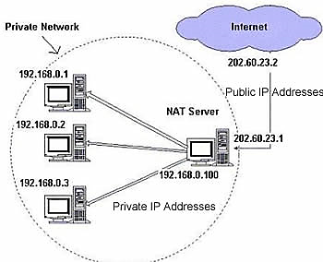
PUBLIC and PRIVATE IP ADDRESSES

Slide 6

Characteristics of network topologies, types and technologies
• Wired topologies
- Logical vs. physical
- Star
- Ring
- Mesh
- Bus

Slide 7
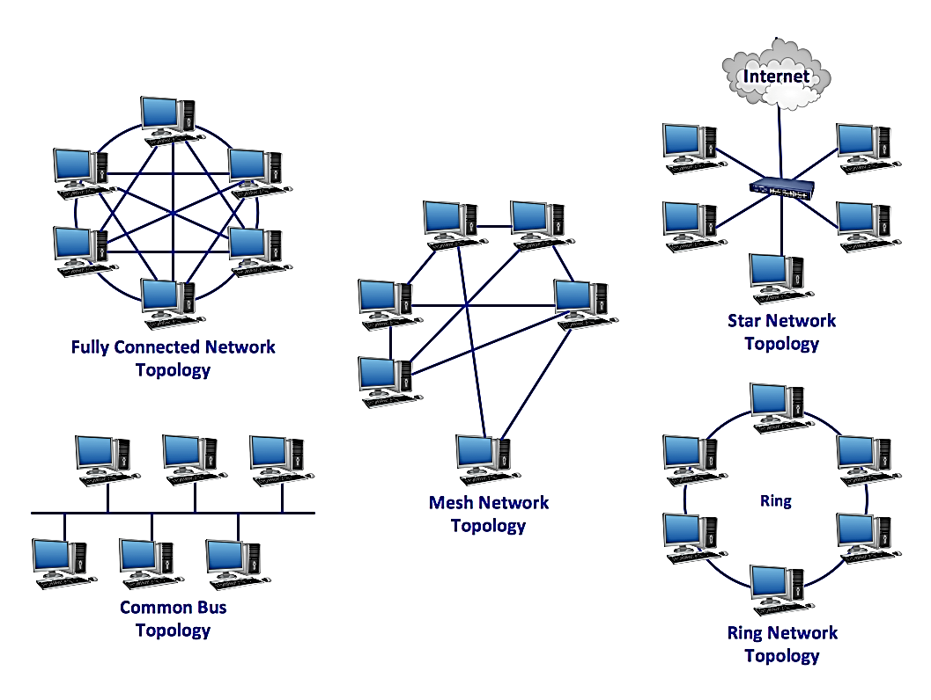

Slide 8
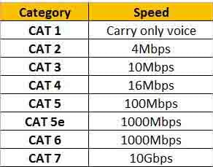
Cabling Solutions

Slide 9
Cabling Solutions
• Copper termination standards
- TIA/EIA 568a
- TIA/EIA 568b
- Crossover
- Straight-through

Slide 10
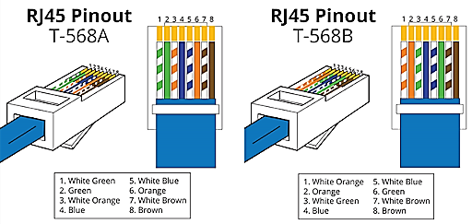

Slide 11
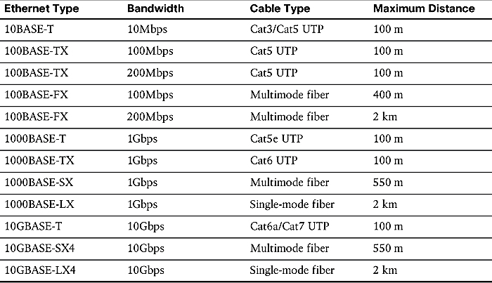
Cabling Solutions

Slide 12
Characteristics of network topologies, types and technologies
Wireless topologies
Mesh / Ad hoc
Mesh / Infrastructure
And / or

Slide 13
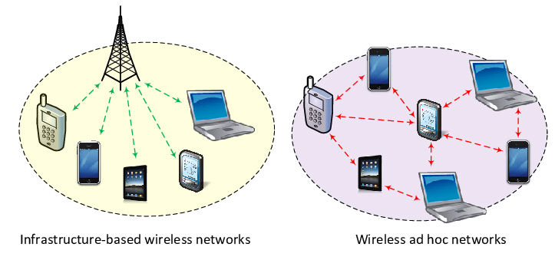

Slide 14
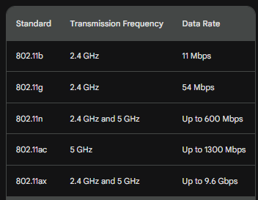
wireless technologies and configurations

Slide 15
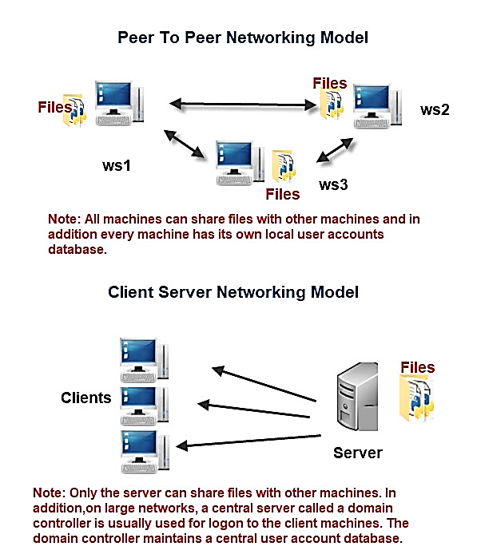

Slide 17
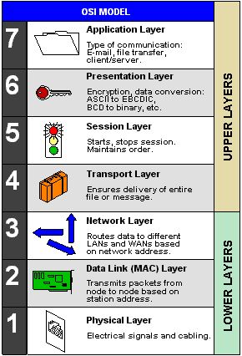

Slide 18
MAC ADDRESSES
IP ADDRESSES
PORT NUMBERS

Slide 19
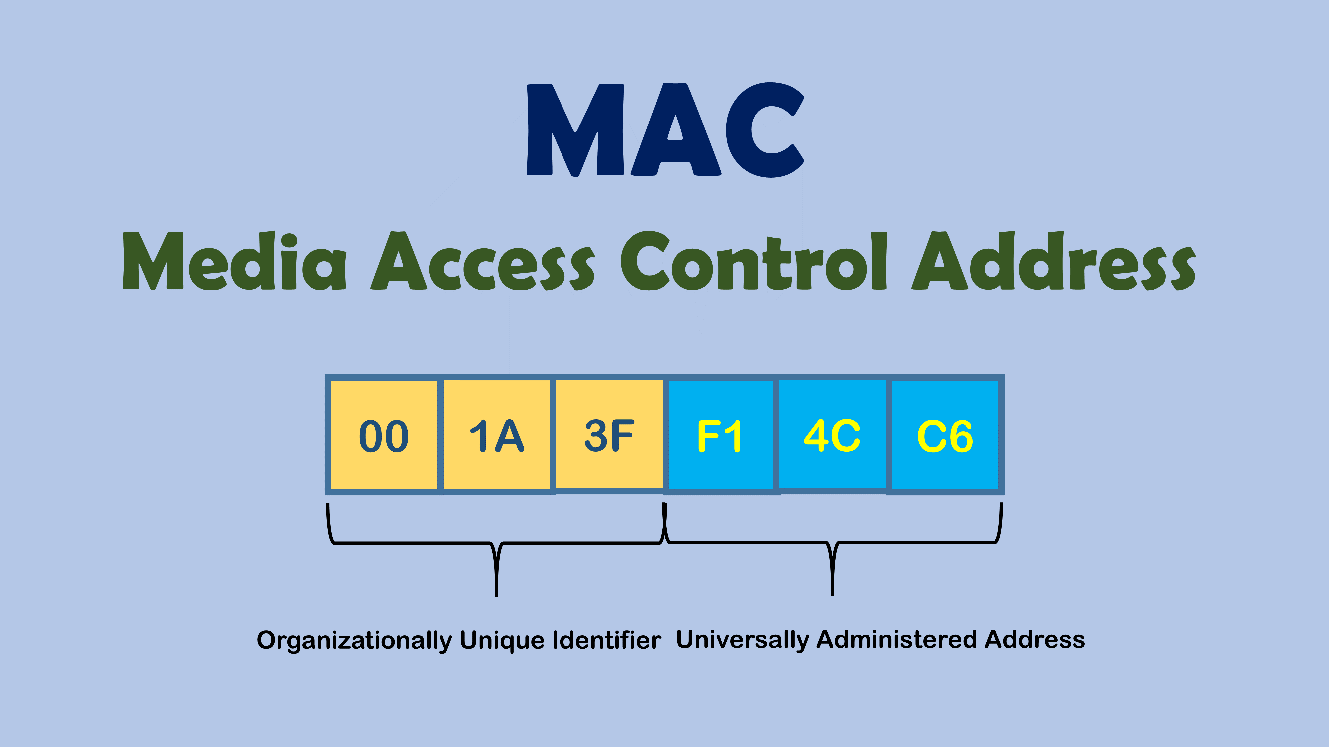
Identifying the vendor (https://macvendors.com/)

Slide 20
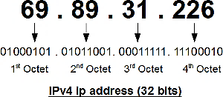

Slide 21
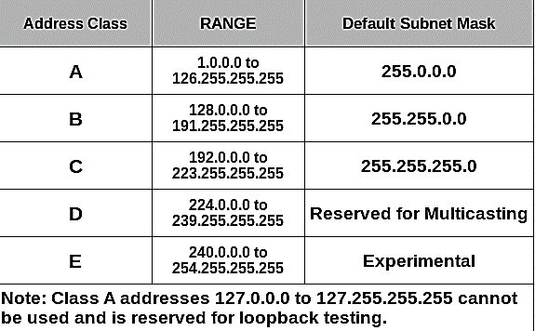
DEFAULT IPv4 CLASSES

Slide 22
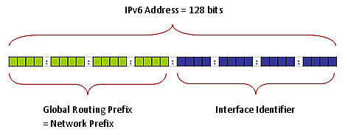

Slide 23
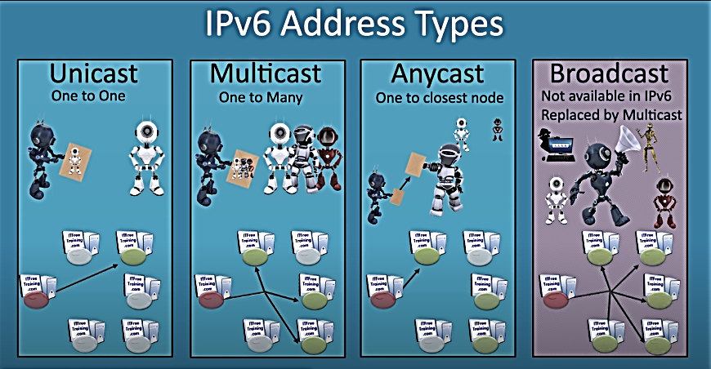

Slide 24
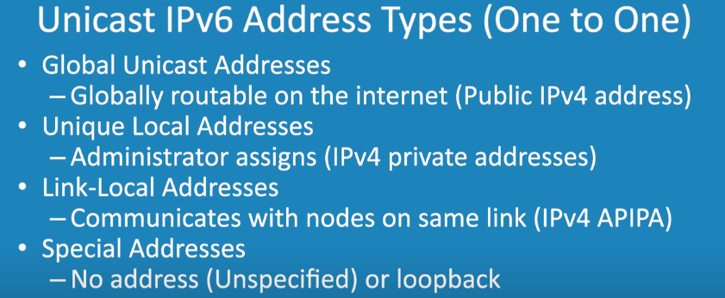

Slide 25
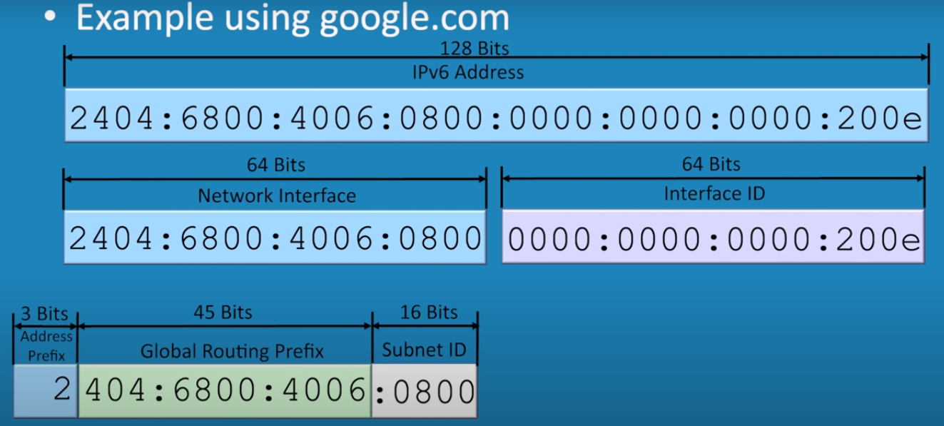
Global Unicast (Internet Routable)

Slide 26
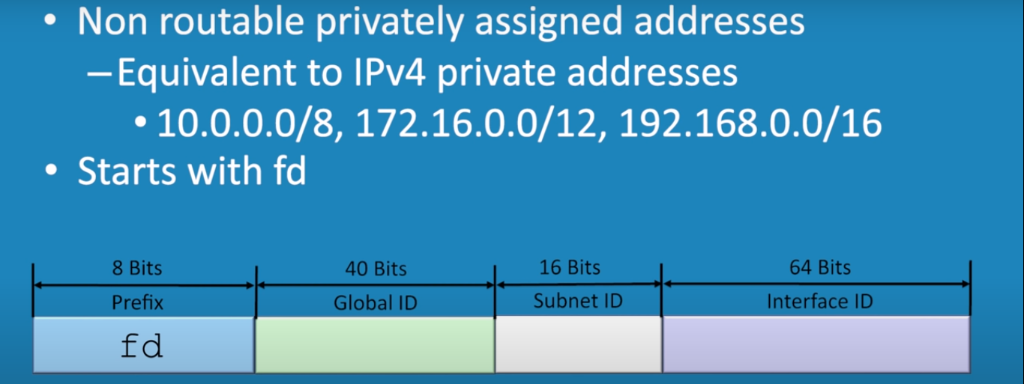
Unique Local (Not Internet Routable)

Slide 27
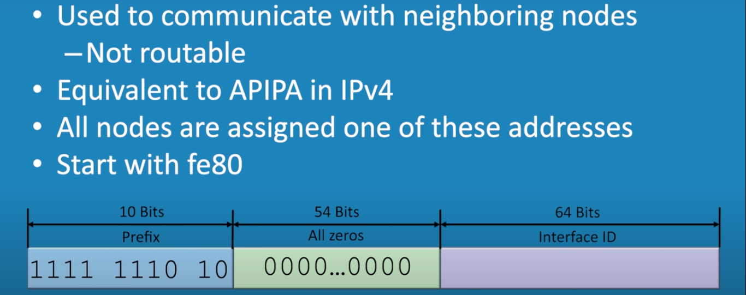
Link Local
(Not Internet Routable, Automatically Assigned in the network)

Slide 28
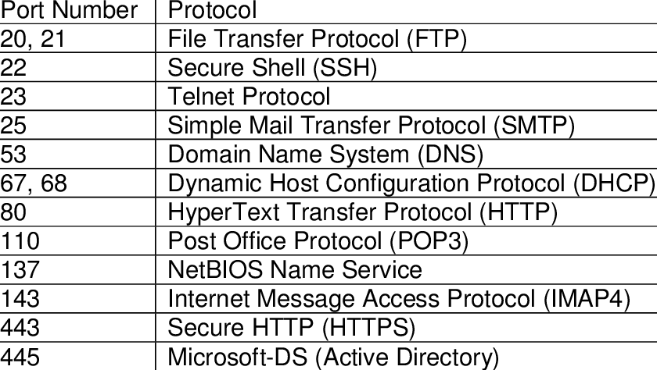
Common Protocols and Ports

Slide 29
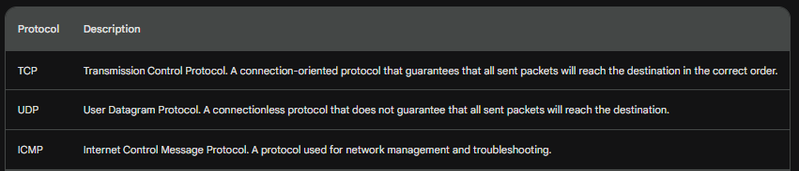
TCP, UDP and ICMP
TCP, UDP, and ICMP are protocols that operate at the transport layer of the TCP/IP networking model. They are used to facilitate communication between devices over a network

Slide 30

IPv4 Addressing and Subnetting
Activities

Slide 31
Windows Commonly Used Network Commands
1. ipconfig (Internet Protocol Configuration):
- Usage examples:
a. Display IP configuration for all network adapters: `ipconfig /all`
b. Release the IP address for a specific adapter: `ipconfig /release "Ethernet"`
c. Renew the IP address for a specific adapter: `ipconfig /renew "Wi-Fi"`
d. Flush the DNS resolver cache: `ipconfig /flushdns`
e. Display only the IPv4 address for all adapters: `ipconfig /all | findstr /R "IPv4"`

Slide 32
Windows Commonly Used Network Commands
2. ping:
- Usage examples:
a. Send ICMP echo requests to a specific host: `ping www.google.com`
b. Set the number of echo requests to send: `ping -n 10 www.example.com`
c. Resolve and display the IP address of a host: `ping -a 192.168.0.1`
d. Continuously send echo requests to a host: `ping -t 192.168.1.1`
e. Disable the reverse DNS lookup: `ping -n 5 -r www.example.com`

Slide 33
Windows Commonly Used Network Commands
3. tracert (Trace Route):
- Usage examples:
a. Trace the route to a specific host: `tracert www.microsoft.com`
b. Set the maximum number of hops to reach the destination: `tracert -h 30 www.example.com`
c. Resolve and display host names along the route: `tracert -d www.google.com`
d. Enable ICMPv6 traffic for tracing IPv6 routes: `tracert -6 www.example.com`
e. Use a specific source IP address for tracing: `tracert -s 192.168.0.10 www.example.com`

Slide 34
Windows Commonly Used Network Commands
4. netstat (Network Statistics):
- Usage examples:
a. Display all active network connections: `netstat -a`
b. Show listening ports and associated processes: `netstat -ano`
c. Display statistics for specific protocol: `netstat -s -p tcp`
d. Show routing table information: `netstat -r`
e. Display active network connections with resolved hostnames: `netstat -an | findstr ESTABLISHED`

Slide 35
Windows Commonly Used Network Commands
5. nslookup (Name Server Lookup):
- Usage examples:
a. Perform a basic DNS lookup for a specific domain: `nslookup www.example.com`
b. Set the DNS server to use for the lookup: `nslookup www.example.com 8.8.8.8`
c. Perform a reverse DNS lookup for an IP address: `nslookup 192.168.0.1`
d. Enable debugging mode for detailed information: `nslookup -d www.example.com`
e. Query for a specific record type, such as MX or NS: `nslookup -type=MX example.com`

